Slide 1
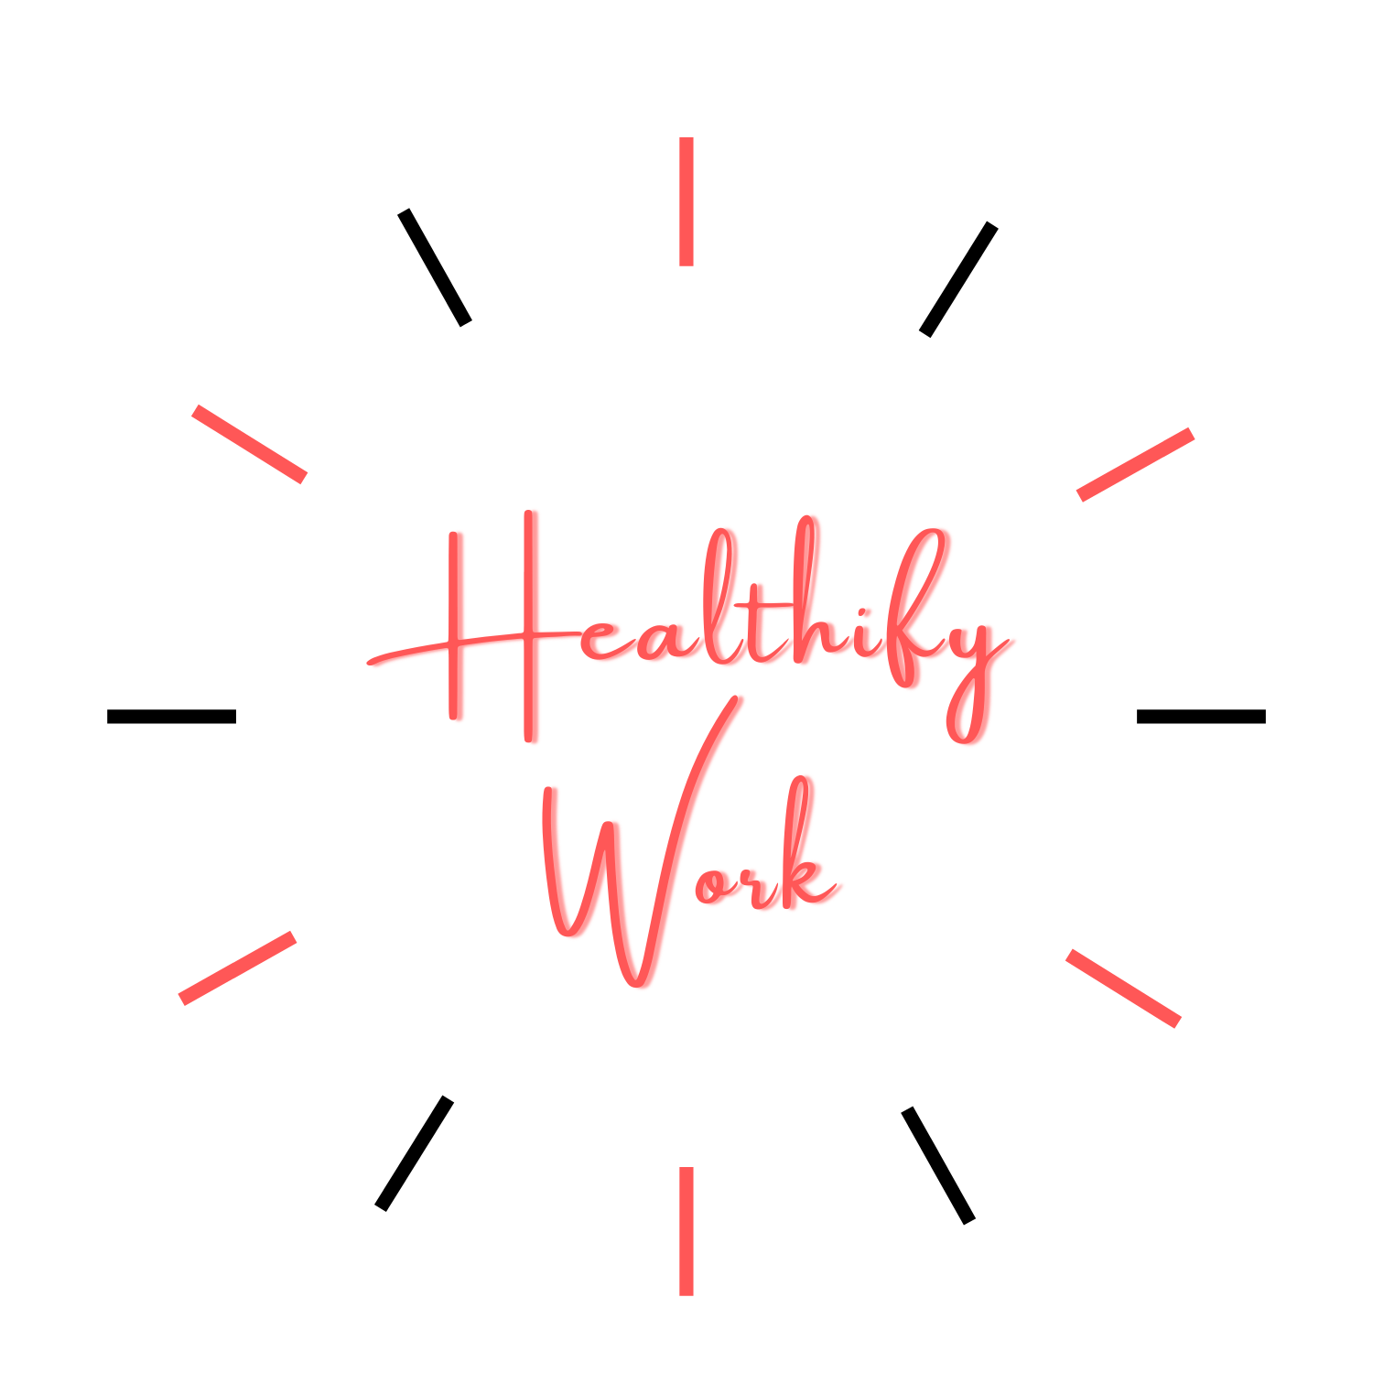

Slide 2
Problems Faced in Current Situation*
Currently 2020 is Covid-19 pandemic era
Almost everything is online now like online school classes, working from home, competitions and meetups like MUN, Hackathons, TIECon , TEDx etc.
It is difficult to keep track of time while working online.
Sitting for long on gadgets I.e. Laptops & mobile phones results in :
Strain on our eyesight, dry eyes , increase in number of Spectacles
Headaches
Poor Posture Syndrome
Inactivity can lead to obesity and other diseases
* Need of an Hour is an App which manages our health along with our work.

Slide 3
Solution to this Problem effecting our health and lifestyle
Healthify Work

Slide 4
About App
* Precaution is better than cure
Healthify Work App is an unique health care wellbeing app for both Adults and Kids
It solves universal problem of working long hours online and its side effects on health
helps in taking regular breaks from online work.
gives an alert when you need to take a break from screen time and when you need to go back to work.
Guides about the healthy lifestyle options
Gives options to improve your wellbeing and lifestyle by Yoga exercises, eyes exercises, healthy recipes and soulful meditation
Helps in improving both physical and mental health

Slide 5
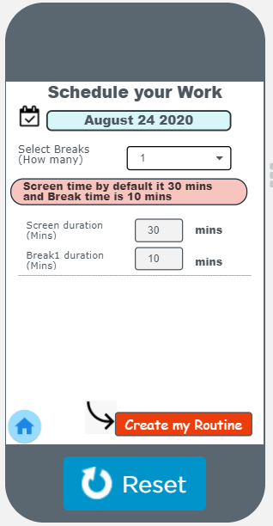
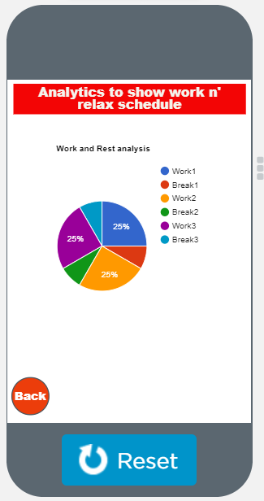
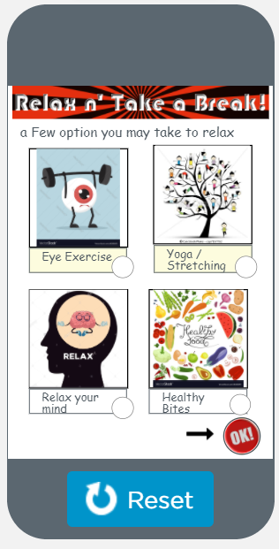
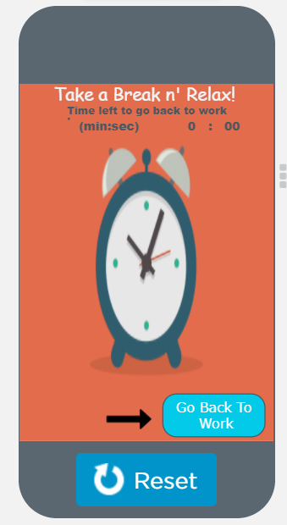
Sneak Peek of Healthify Work

Slide 6
Thank You!
Application : Healthify Work
Developed by: Divij Chaudhry
Presentation by : Divij Chaudhry

